Slide 1




x
FIU COIL
Final Presentation

Slide 2
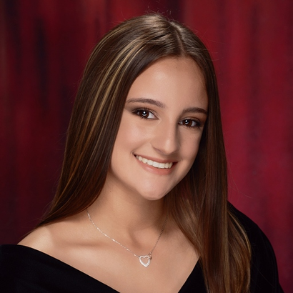
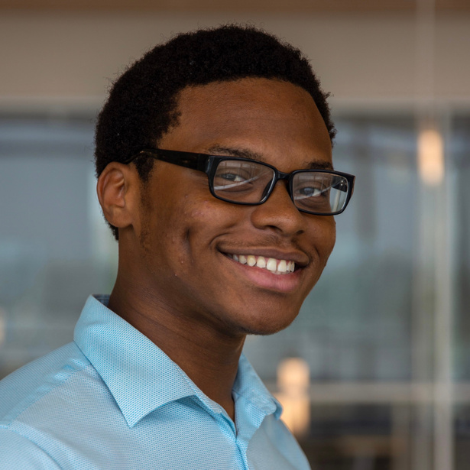
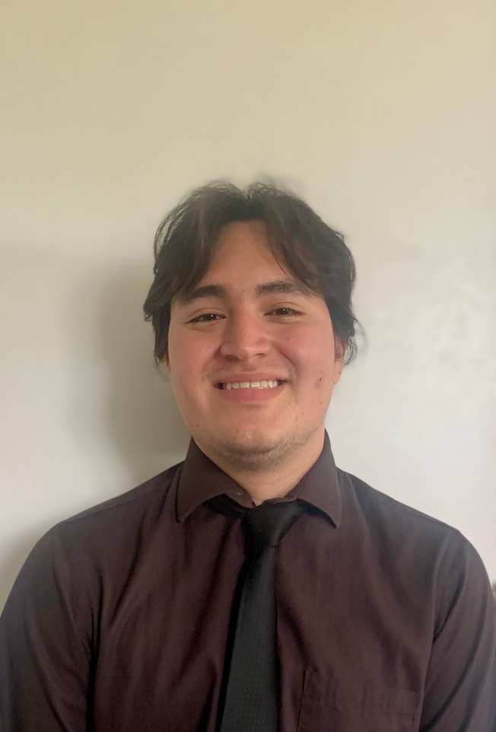
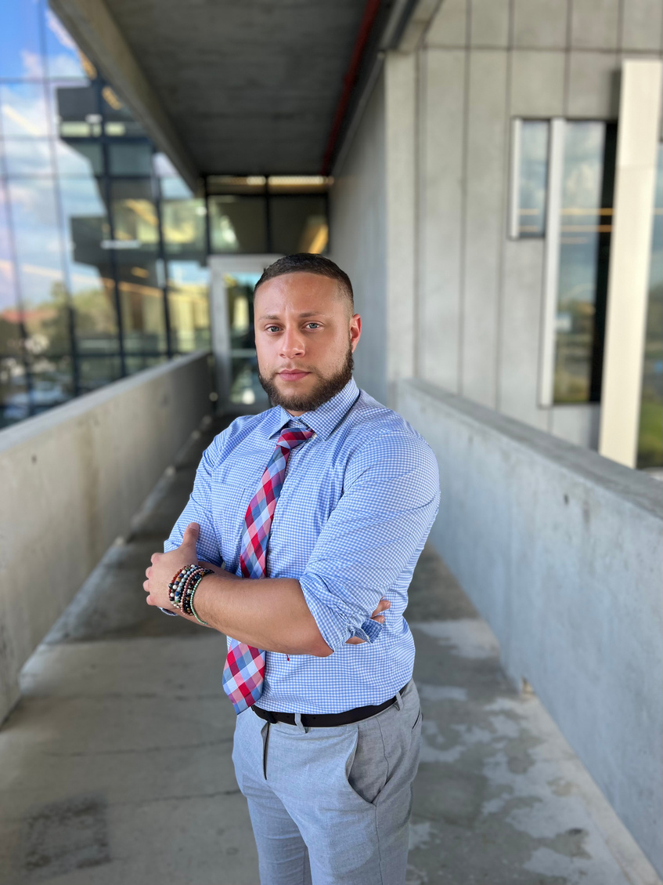
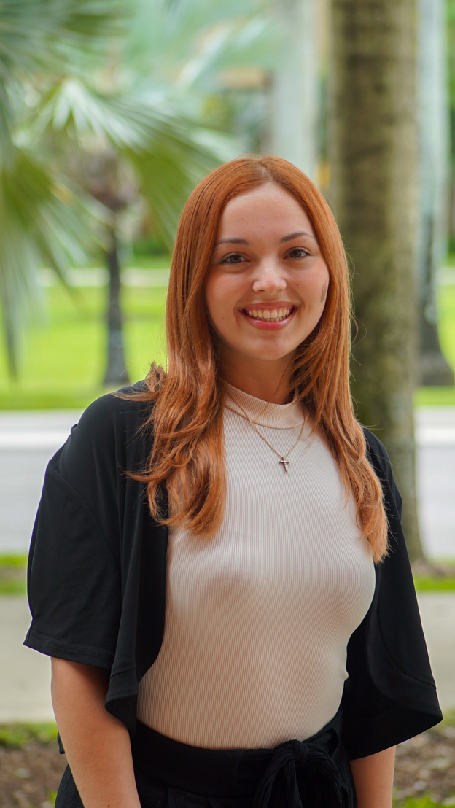
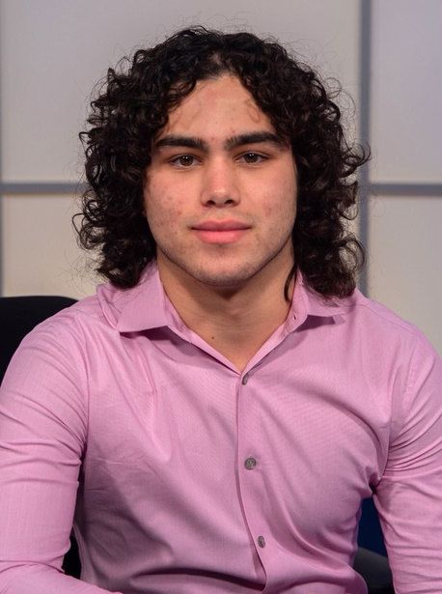
Meet The Team
Estefani Calandriello
Joshua Roc
Juan Angeles
Account Supervisor
Account Executive
Strategist
Zac Campos
Anabelle Ramos
Norman Mayorga
Social Media Specialist
Digital Specialist
Design Specialist

Slide 3
List of Contents
  Goals/Objectives
  Target Audience
  SWOT Analysis
  Social Media Strategy
  Top Performing Content
  Overall Analytics
  BOLD Recommendations

Slide 4
  01
  Create engaging videos about the Fundamentals of COIL Design.
Objectives
  02
  Become more active on LinkedIn.
FIU COIL
What were FIU COIL’s objectives for Spring 2024?
  03
  Prioritizing Instagram as a way to reach students.

Slide 5


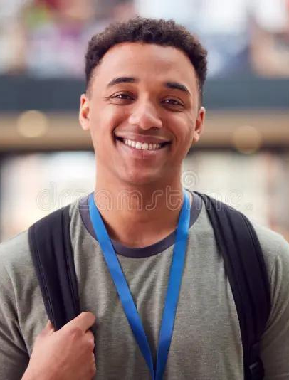

TARGET AUDIENCE
What are FIU COIL’s target audiences?
Name: Brian
Age: 21
Gender: Male
Occupation: Full-time student
General Description:
  Brian is a full-time student majoring in art history and wants to understand the history of art across different cultures.
Name: Sarah
Age: 30
Gender: Female
Occupation: Professor
General Description:
  Sarah is a professor of communication at FIU and wants to help students understand the different forms of communication across cultures.
College Students
Faculty

Slide 6
Strengths
S
  A free, alternative to studying abroad
  A unique learning experience for students
  Professional development and networking opportunities for faculty
Weaknesses
W
  Inconsistent social media presence
  Website
  Not enough promotion of other events, like the webinar series

Slide 7


Opportunities
O
  Doing tabling events
  Collaborative posts with FIU sister pages
  Having an alternative logo
Threats
T
  Competition (The Steven’s Iniative, EF International, FIU Study Abroad)
  Obscurity/Students being completely unaware of FIU COIL

Slide 8



SOCIAL MEDIA STRATEGY
  Employing successful trends from Tik Tok
  Breaking down the ambiguity of FIU COIL
  Highlighting the international experience gained from COIL projects and programs

Slide 9
February-March 2024
CONTENT CALENDAR
INSTAGRAM POSTS
LINKEDIN POSTS
SUNDAY | MONDAY | TUESDAY | WEDNESDAY | THURSDAY | FRIDAY | SATURDAY
18 | 19 | 20 | 21 | 22 | 23 | 24
18 | 19 | 20 | 21 | 22 | 23 | 24
25 | 26 | 27 | 28 | 29 | 01 | 02
25 | 26 | 27 | 28 | 29 | 01 | 02
03 | 04 | 05 | 06 | 07 | 08 | 09
03 | 04 | 05 | 06 | 07 | 08 | 09
10 | 11 | 12 | 13 | 14 | 15 | 16
10 | 11 | 12 | 13 | 14 | 15 | 16
17 | 18 | 19 | 20 | 21 | 22 | 23
17 | 18 | 19 | 20 | 21 | 22 | 23
STORIES
JAPAN REEL WORKSHOP
IG: WERE FIU COIL OFC...
IG: JAPAN REEL WORKSHOP
WHAT IS FIU COIL
REEL: WHAT DOES COIL STAND FOR
STUDY ABROAD OPPERTUNITIES
AACU STUDENT EVENT ANNCOUMENT
SPAIN TRIP (POV REEL)
COILS DIGITAL DIARY PART 1: SPAIN
COILS DIGITAL DIARY PART 2: SPAIN
COILS DIGITAL DIARY PART 1: SPAIN

Slide 10
March-April 2024
CONTENT CALENDAR
INSTAGRAM POSTS
LINKEDIN POSTS
SUNDAY | MONDAY | TUESDAY | WEDNESDAY | THURSDAY | FRIDAY | SATURDAY
24 | 25 | 26 | 27 | 28 | 29 | 30
24 | 25 | 26 | 27 | 28 | 29 | 30
31 | 01 | 02 | 03 | 04 | 05 | 06
31 | 01 | 02 | 03 | 04 | 05 | 06
07 | 08 | 09 | 10 | 11 | 12 | 09
07 | 08 | 09 | 10 | 11 | 12 | 09
STORIES
SPAIN PART 2
SPAIN PART 3
SPAIN PART 2
SPAIN PART 3
COLLAB REEL WITH FIU GLOBAL
WHM RECAP POST
ARTISTIC EXPRESSIONS REEL

Slide 11


Day of Upload
How did it perform the day of upload?

Slide 12
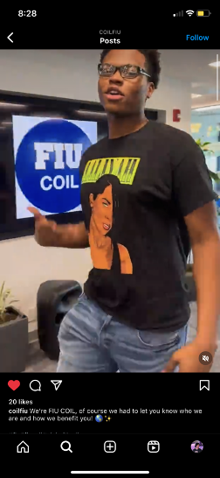
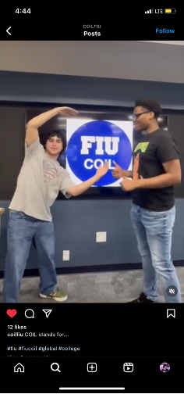
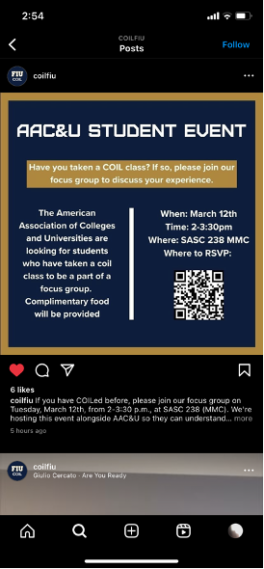

Slide 13






Week After Upload
How did it perform a week after?

Slide 14
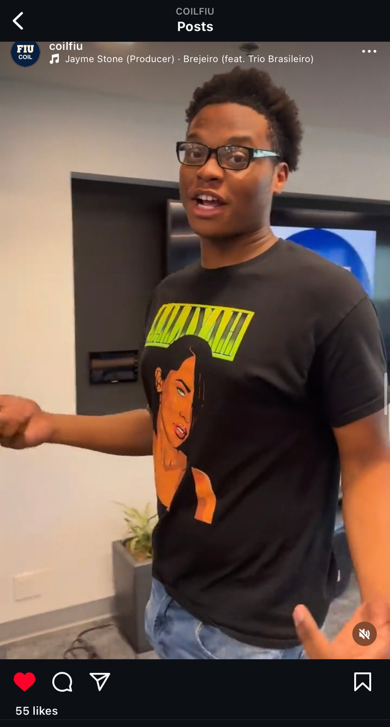
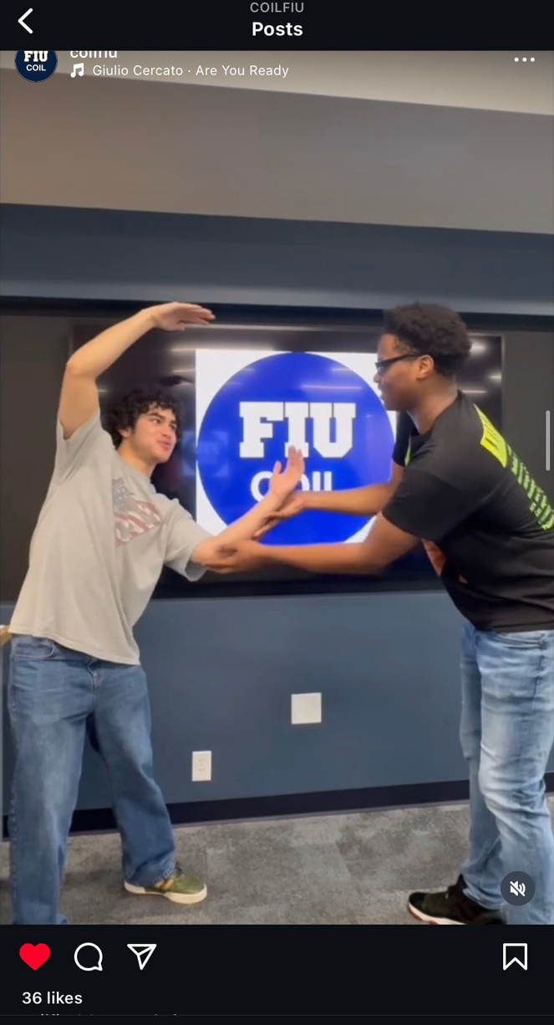
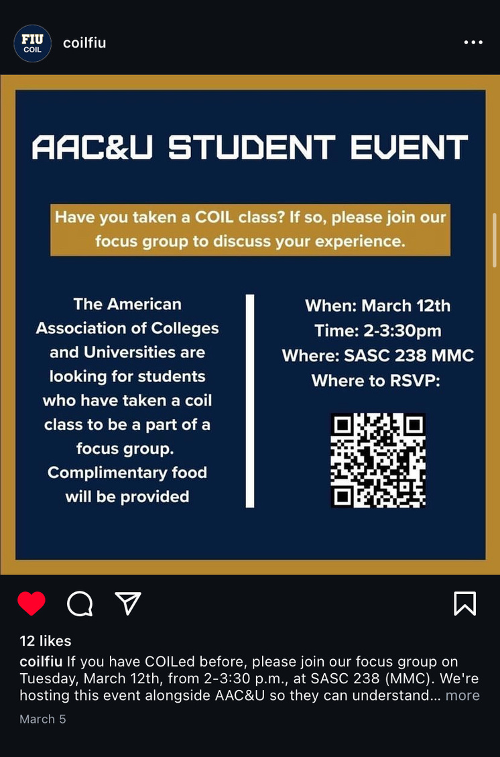


Slide 15














TOP 5 PERFORMING CONTENT
  We’re FIU COIL, of course we... Reel Trend
  COIL Japan Trip Recap Reel
  What COIL Stands For Reel
  Collaborative POV Video Reel with FIUGLOBAL
  While At The Museum Avatar Reel

Slide 16

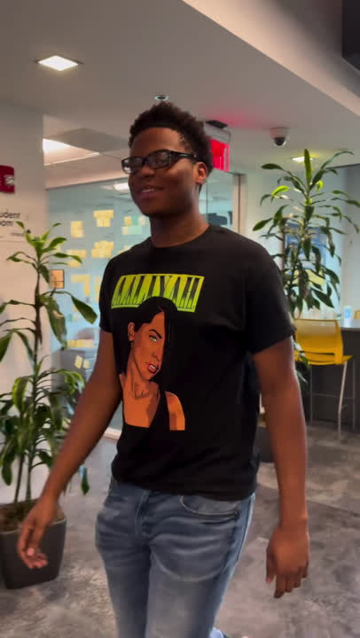

OVERALL ANALYTICS + CAPTION STRATEGY
We’re FIU COIL, of course we... Reel Trend
Likes = 55
“We’re FIU COIL, of course we had to let you know who we are and how we benefit you!”
#fiu #fiucoil #global #college
Accounts reached = 436
127 followers | 309 non-followers
820 plays

Slide 17
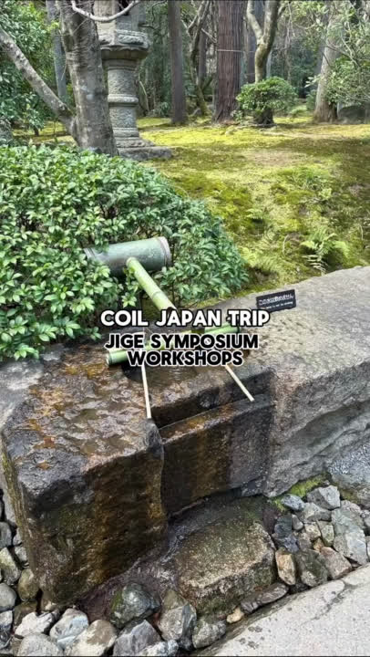

OVERALL ANALYTICS + CAPTION STRATEGY
COIL Japan Trip Recap Reel
Likes = 40
The Japan Hub for Innovative Global Education is a groundbreaking global education initiative by three Japanese Universities (Kansai University, Tohoku University, and Chiba University) whose mission is to revolutionize higher education and workforce development through innovative virtual, blended mobility, and internship programs
Here’s a glimpse of the amazing experience, such as connecting with speakers, workshop facilitators, and seeing unique parts of Japan.
#fiu #fiucoil #global #kansaiuniversity #tohokuuniversity#chibauniversity
Accounts reached = 314
75 followers | 239 non-followers
686 plays

Slide 18
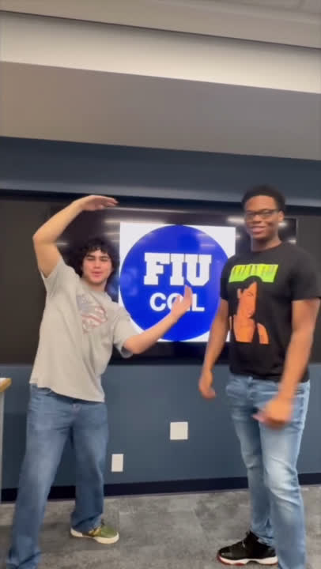
OVERALL ANALYTICS + CAPTION STRATEGY
What COIL Stands For Reel
Likes = 36
Accounts reached = 312
134 followers | 178 non- followers
“COIL stands for...”
#fiu #fiucoil #global #college
482 plays

Slide 19
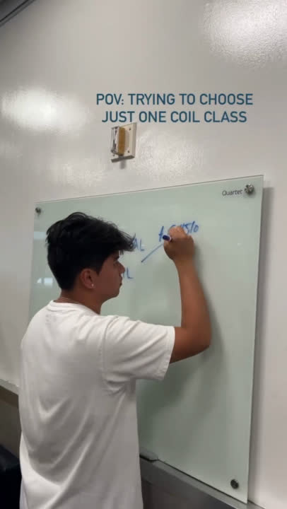
OVERALL ANALYTICS + CAPTIONS STRATEGY
Collaborative Repost POV Video Trend with FIUGLOBAL
Likes =21
COIL, or Collaborative Online International Learning, is a curriculum that involves peer-to-peer intercultural dialogue and meaningful cross-cultural projects. COIL classes are intentionally designed with icebreakers, collaborative tasks, and reflections that expose students to the world and its diversity without incurring additional costs.
Some examples of COIL classes include Writing Across Borders, Artistic Expression in a Global Society, and many more.
The deadline to register for summer and fall COIL classes is May 5. Don’t miss out on this global learning experience! 🌎
#FIU #FIUGlobal #COIL #classregistration #fallsemester
Accounts reached = 298
114 followers | 184 non-followers
459 plays

Slide 20
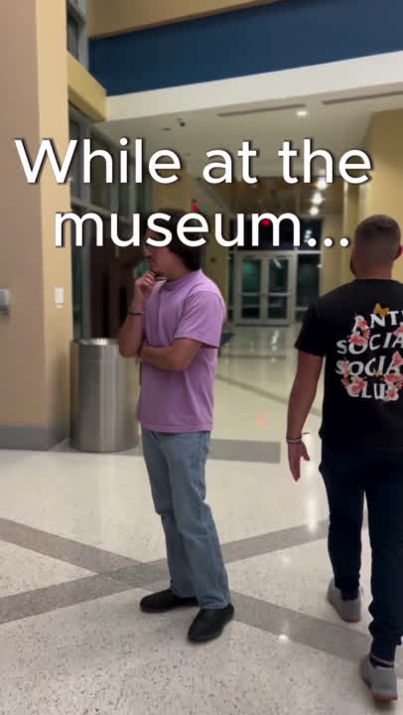
OVERALL ANALYTICS + CAPTION STRATEGY
While At The Museum Avatar Reel
Likes = 17
Under the guidance of Dr. Maria Marino and Dr. Nadera Alborno, students from FIU and the American University in Dubai (@audubai) collaborated to create a virtual museum that provides essential resources about disability. The COIL project, “Artistic Expressions of Disability in Education”, aimed to educate people about disability while creating an interactive experience and incorporating the latest trends in technology, like VR.
Click the link in the bio to support this project by creating your own avatar character and becoming more aware of disability resources ✨
#fiu #fiucoil #college #autism #autismawareness#autismawarenessmonth #disability #disabilityawareness
Accounts reached = 124
108 followers | 16 non-followers
215 plays

Slide 21



Overall Analytics
FEB.20 - NOW
1,023
Accounts reached
+6,433%
188
Followers
4, 099 Impressions +1,379%
+2,219%
835
Non-Followers
293 Profile Activity
+324%

Slide 22
BOLD Recommendations
  Improving the website
  Exploring alternative logos/merch
  Having more content targeted to students on LinkedIn
  Creating interactive content posts with poll features, asking students for what they want to see from COIL
  Collaboration posts with sister FIU pages
  Creating an archive of COIL projects
  Promote events more on social media

Slide 23
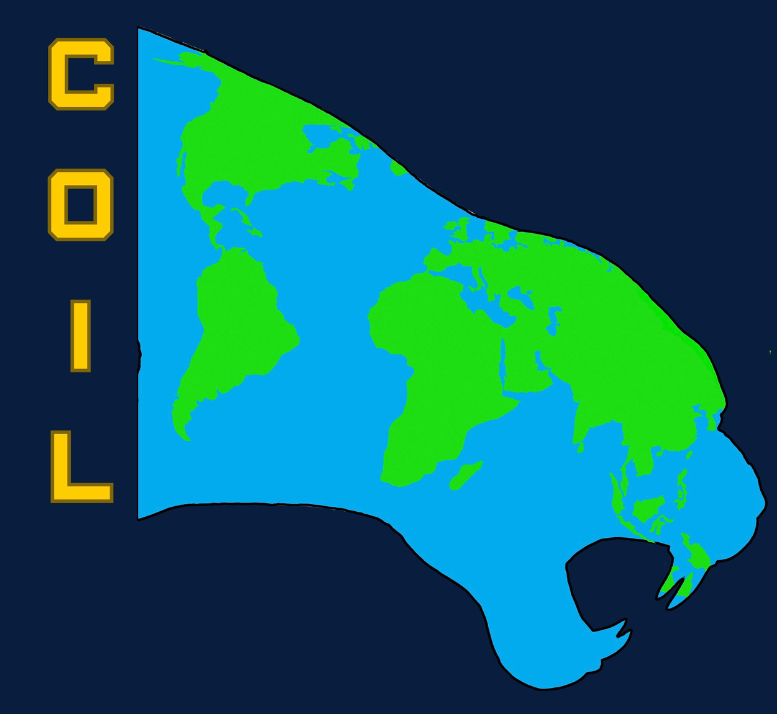


Slide 24
Thank You!

